Slide 1
Checkers
International Women's Day Hackathon 2015
Developed By..
Vinnie Da Silva
Pratima L. Gauns

Slide 2
Concept
While playing an interesting real world board game with your best buddy, what would you do if you are called by some urgent work? Unfortunately, you’ll have to leave the game in the middle and run away.
What if you could capture the game’s state on a device easily and resume the play on the device after some time.
That’s the concept we tried demonstrating through our app using a Checker Board game.

Slide 3
Requirements
Targeted devices – iPad Application. Tested on iPad 3 and iPad 4
OS – iOS 8 and above.
Orientation – Portrait mode
Requirement to build the App:
OSX 10.9.4+
Xcode 6.1+
iOS 8.0+

Slide 4
Screens
Screen 1- Image Capture Screen
Allows you to capture an image.
Adjust the iPad camera to correctly fit the displayed frame with your game board. Once done tap the screen to capture.
We detect the board edges and show the preview of the captured image. User can either select the image and tap on “Next” or opt to recapture using “Reset”.
The “Select Demo Picture” allows to select a static picture for demo purpose in case game board is not available for capturing image.

Slide 5
Screens
Screen 1- Image Capture Screen Continued
The “Select Demo Picture” allows to select a static picture for demo purpose in case game board is not available for capturing image.

Slide 6
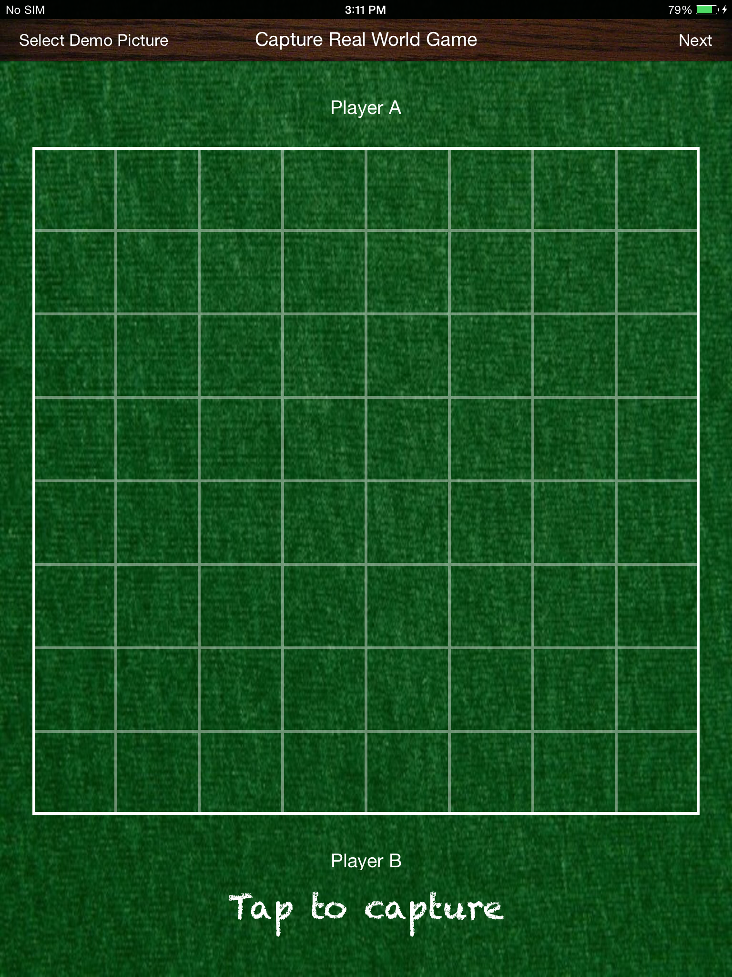
Initial screen with grid view to help user to capturing the image of the board

Slide 7
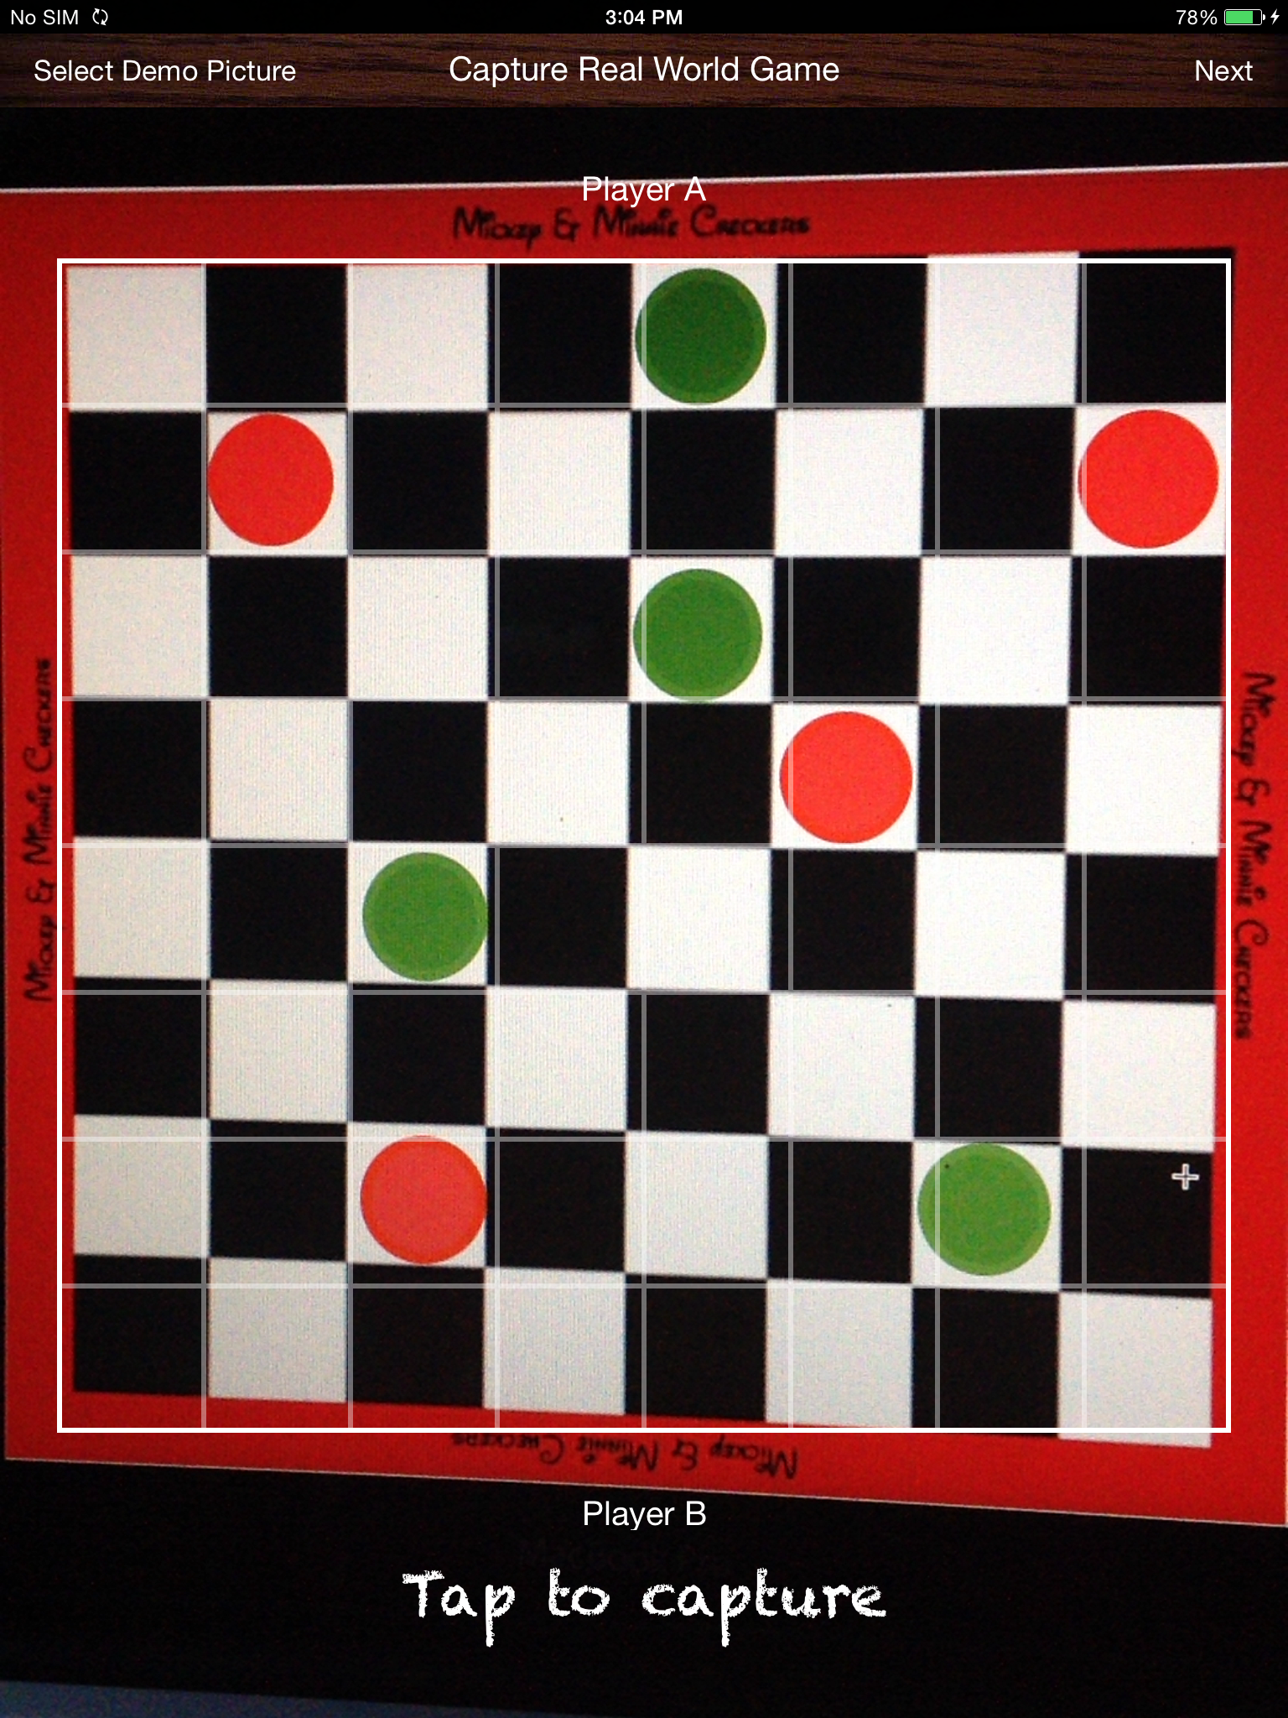
Click on the “Tap to capture” once done adjusting the camera over the board.

Slide 8
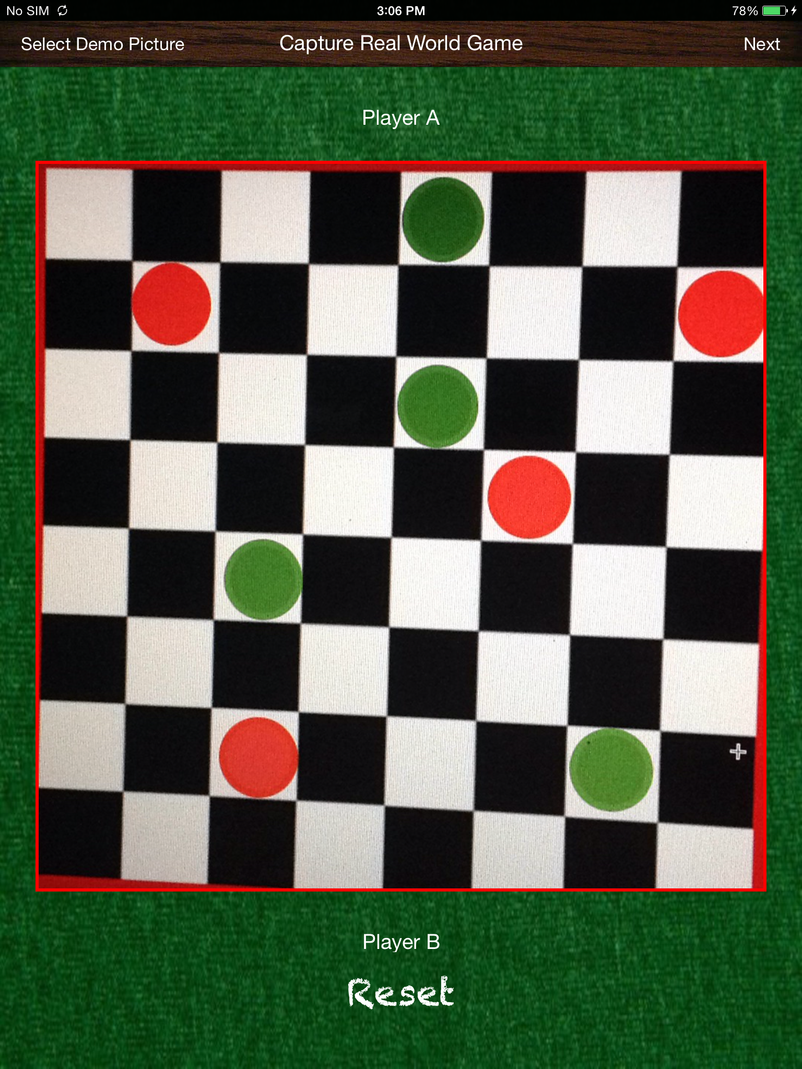
Screen showing the preview of captured image after board detection.

Slide 9
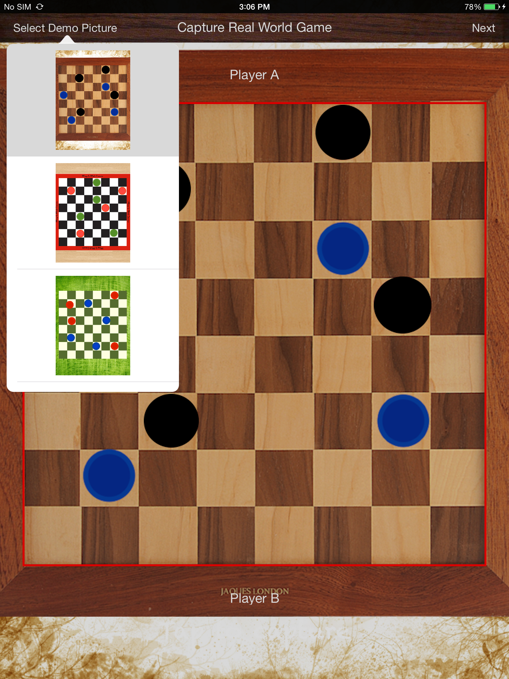
Popover shown on tapping “Select Demo Picture” for demo with pre-capture images.

Slide 10
Screens
Screen 2 – Game Screen
The captured image is passed to this screen. Which detect the colors for each check and draw them to present the board.
Using Image Processing techniques, we detect the coins within each check. Find out the color of each coin and draw them with their actual colors.
The coins can be moved across to proceed with game play. Long press the coins and move them across by pan gesture.

Slide 11
Screens
Screen 2 – Game Screen Continued
Due to time constraints we have implemented the only diagonal coin movement for demonstration purpose. The actual game logic is not added.

Slide 12
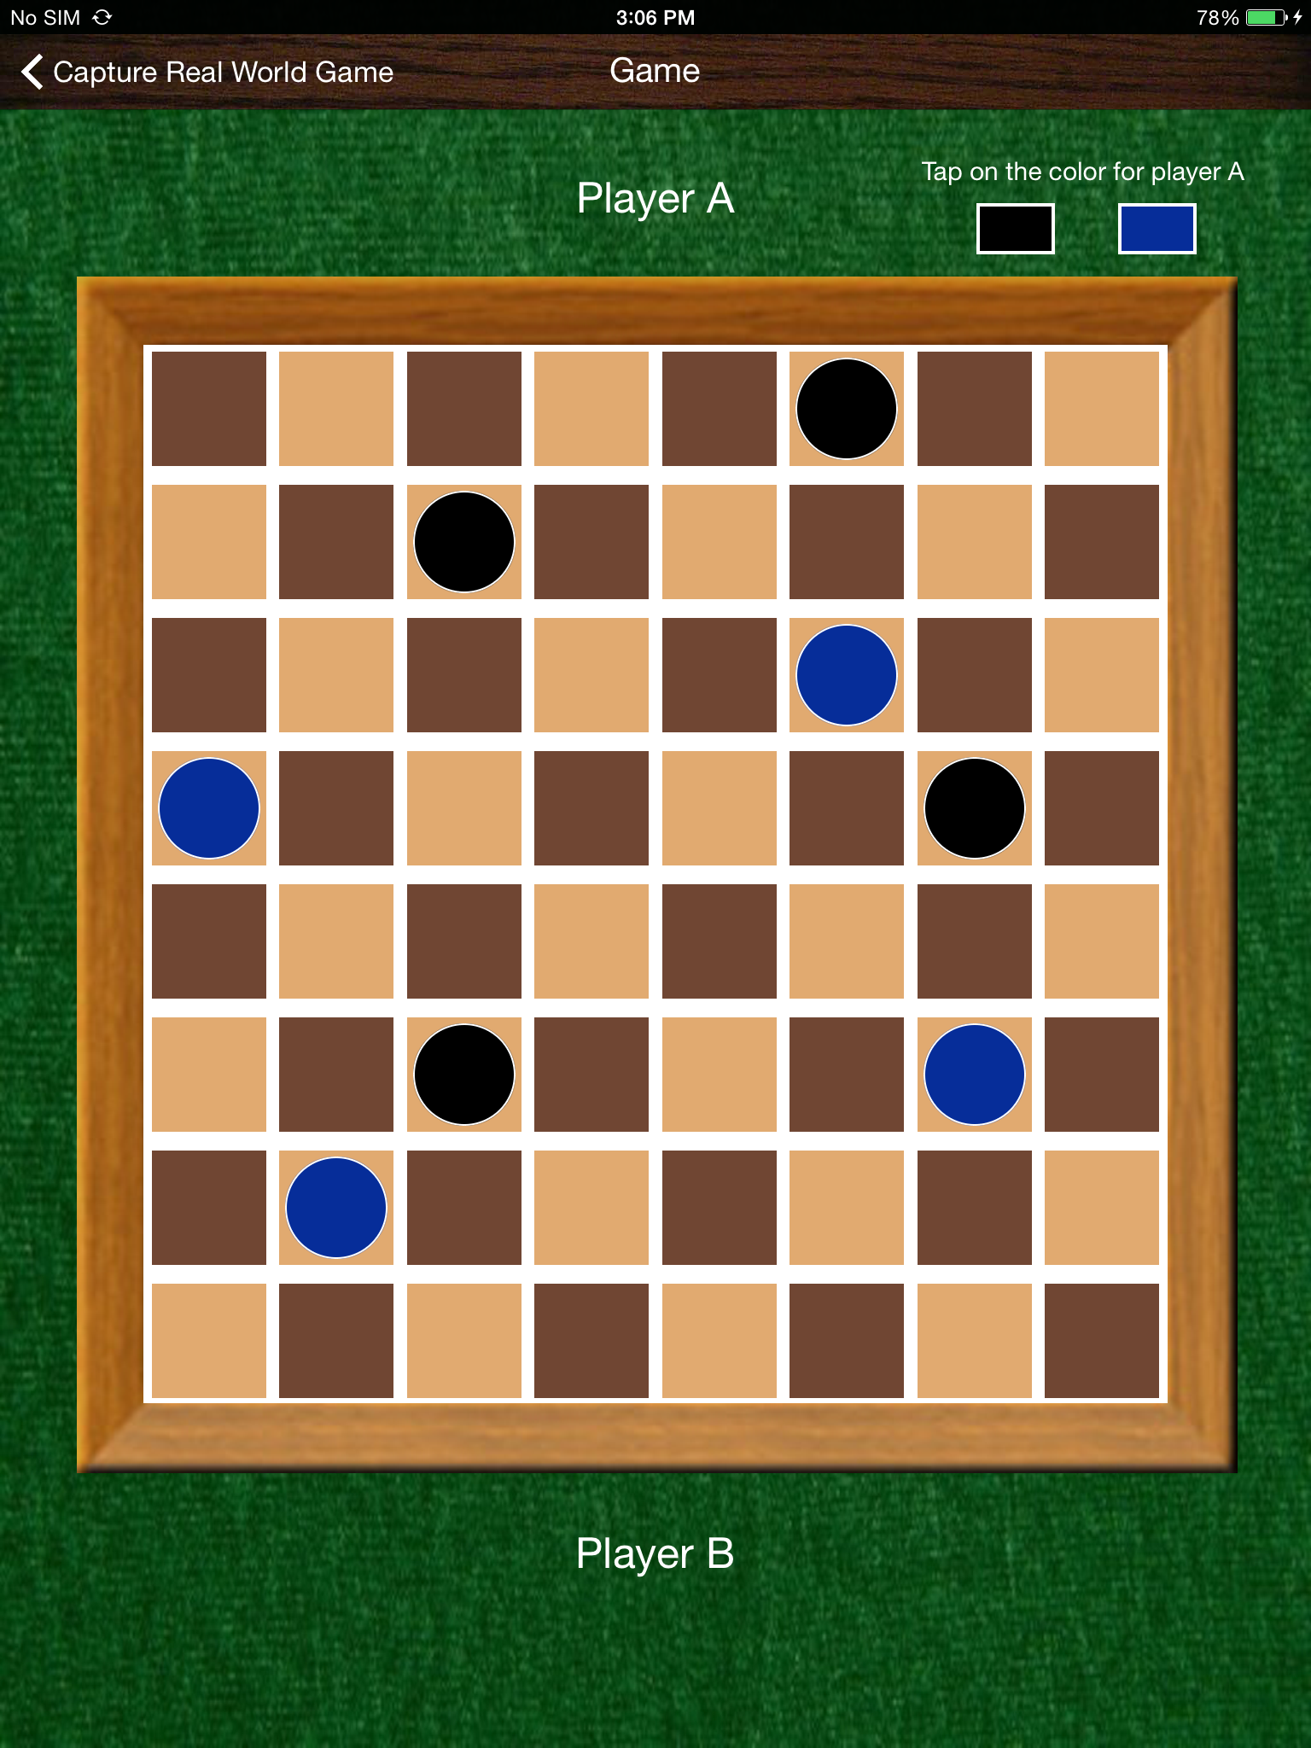
Board drawn with the detected coins and the color.

Slide 13
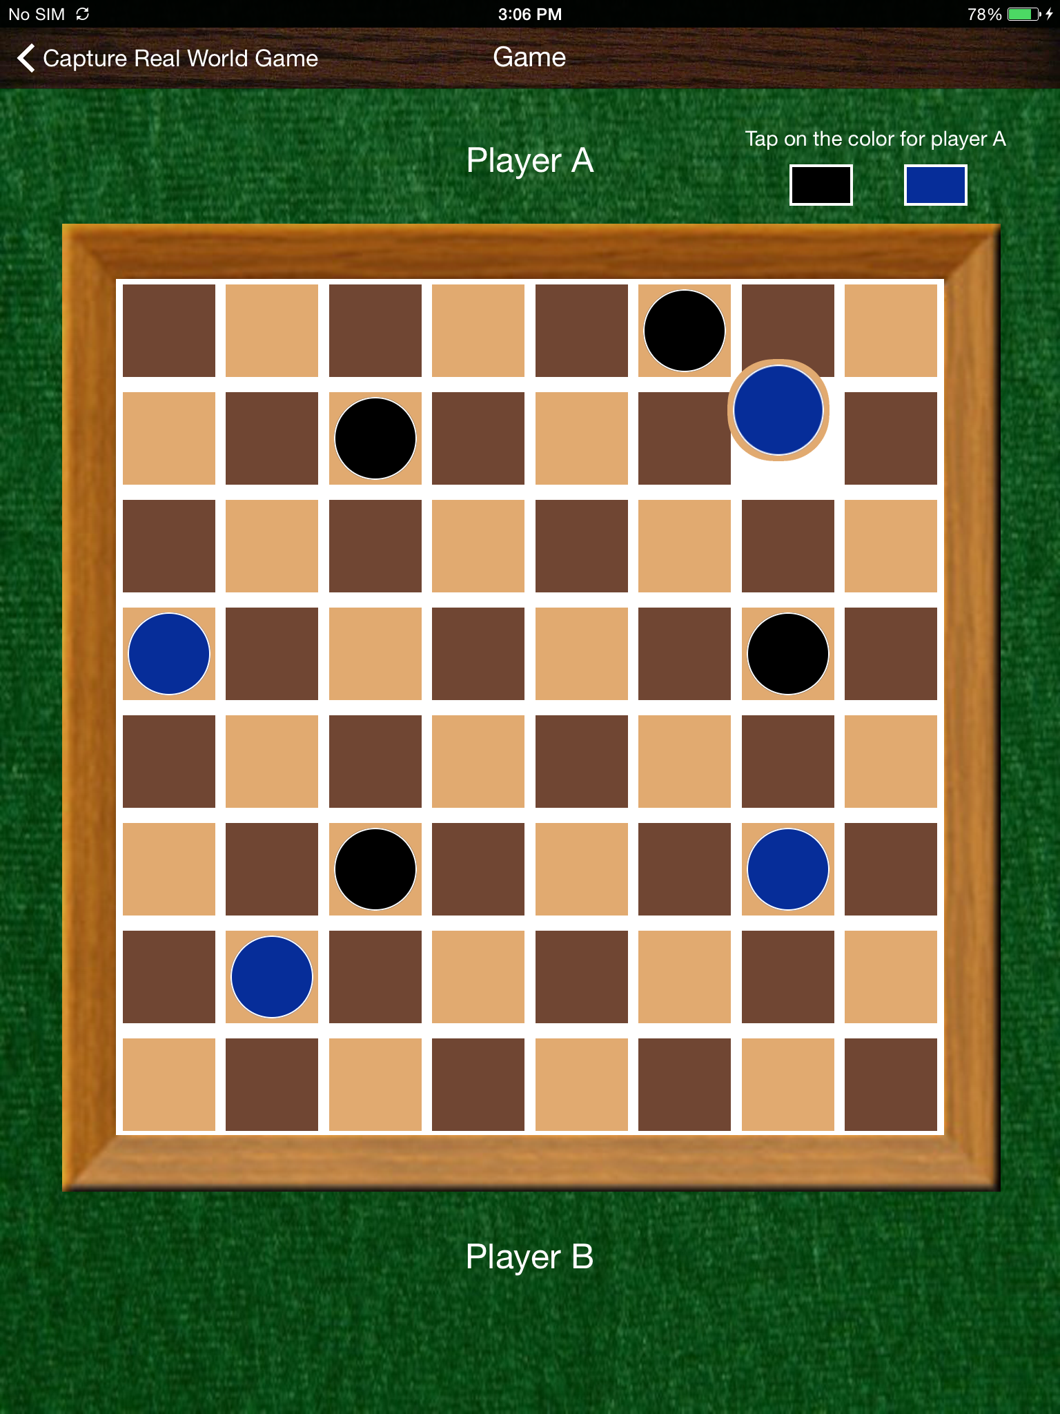
Long press and pan to move the coin diagonally.

Slide 14
Tools and Frameworks
Xcode 6.2
Core Graphics and OpenCV Framework for image processing

Slide 15
References
https://github.com/foundry/OpenCVCircles
https://github.com/lxcid/LXReorderableCollectionViewFlowLayout

Slide 16
Future Improvement
Completing the game logic to enable user to actually proceed with game play.
Improving the board and coin detection algorithms to make them work for noisy and complex images.
Detecting different shaped coins instead of only circular ones.

Slide 17
Thank You!

